Slide 1
The “BIG”
Precision Time Measurement Picture

Slide 2
Part 1 PTM in context:
Why do we care?

Slide 3
PTM – What’s the BIG deal?
Let’s start by talking a little about what problems PTM solves and why PTM is a critically important technology that is poised to receive a lot of attention in the short term.
I’ll do that by talking about what the world currently looks
like.
It is not well understood how big a problem the lack of hyper accurate synchronisation is in your average datacenter server, nor why in the short term PTM as a technology is likely to get a lot of attention.

Slide 4

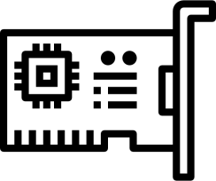

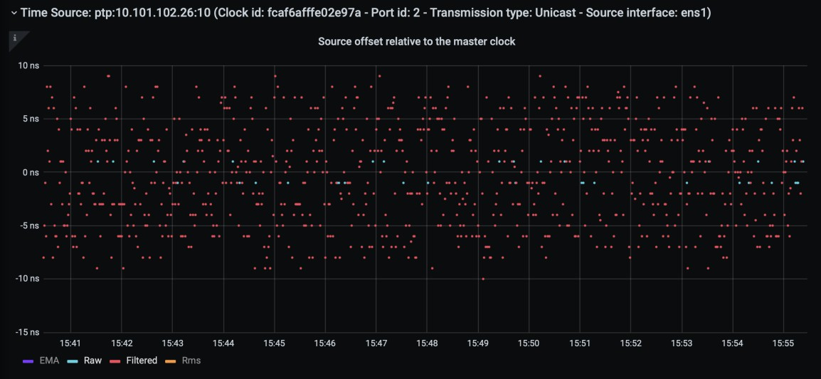
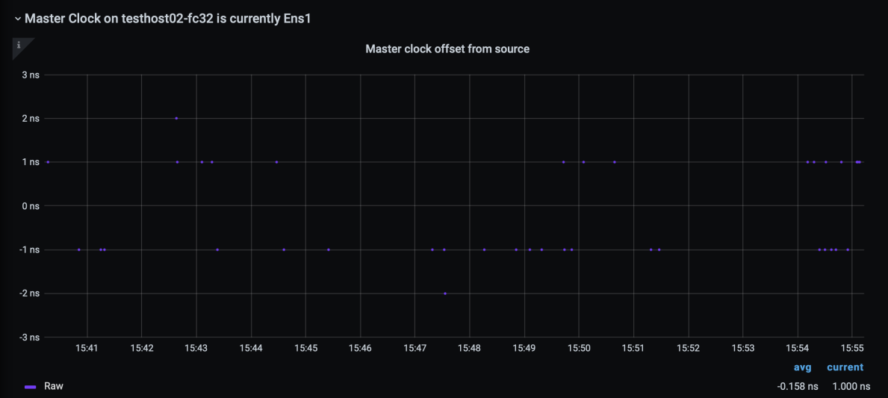
This works great: sub 10ns accuracy - $40 NIC
P
H C
CPU
PHC
to
PHC
CPU
< 10ns accuracy
(Timebeat advanced filtering 2ns theoretical limit possible)

Slide 5
This still sucks: Non-deterministic asymmetry
CPU
PHC
PHC
CPU
50ns – 2,500ns 50ns – 2,500ns
Even with filter algorithms the unknown latency characteristics of the
PCIe bus causes significant variance in the clock accuracy of the CPU
Congestion on the PCIe bus contributes to this
Changes in CPU p-state is a particularly difficult problem to overcome
Improving accuracy requires filtering that consumes considerable CPU
A single server typically contains lots of PHCs

Slide 6
How do we sync the CPU clock from a PHC? (without PTM)
Commonly the ioctl
“PTP_SYS_OFFSET_EXTENDED” is used
In the device driver for a particular NIC (or other PHC device) 3 timestamps are captured.
Two from the CPU interleaved with one from the PHC
It is then assumed that the the interleaved PHC timestamp occurred halfway between the two CPU timestamps
This is frequently a “pretty terrible”™
assumption
To compensate it’s not uncommon to collect these timestamps many time concurrently and use minimum delta between T1a and T1b
Because preemption happens in none-RT
operating systems etc
(xN)
T1a
T2
PHC
T1b
E
v e n t s
Clock Offset =
𝑇1𝑎+𝑇1𝑏 2
− T2
𝐵𝑒𝑠𝑡 𝑠𝑎𝑚𝑝𝑙𝑒: 𝑚𝑖𝑛(𝑇1𝑏₁ − 𝑇1𝑎₁, … 𝑇1𝑏_{𝑛} − 𝑇1𝑎_{𝑛})

Slide 7
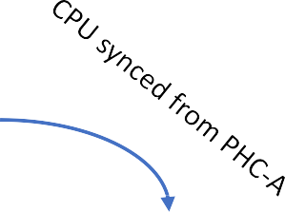
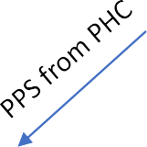
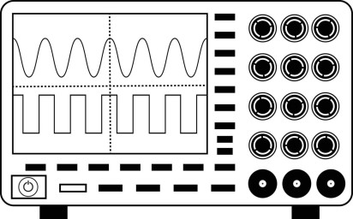
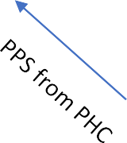
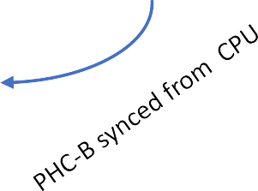
Classic Test: Variance of distribution != Offset
To understand why the offsets displayed by phc2sys for instance in no way reflects the actual offset one can perform the test on the right.
It is not uncommon for the phase difference between the two PPS signals to be hundreds of nanoseconds even if the std.dev of 𝑃₁ and 𝑃₂ is no more than 20ns.
The reason is asymmetry as discussed in previous slide which has not been compensated for.
It can be statically compensated for, but this is not practical in large deployments with varying hardware builds.
PHC-A
𝑷_{𝟏}
𝑷
𝟐
Oscilloscope
Spectroscope∗
PHC-B

Slide 8
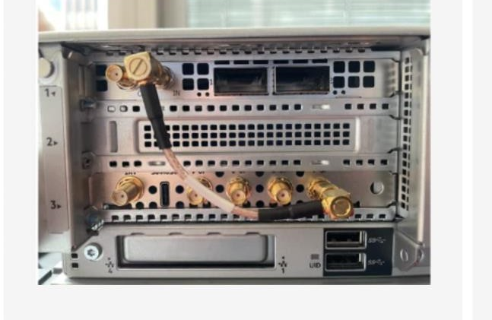
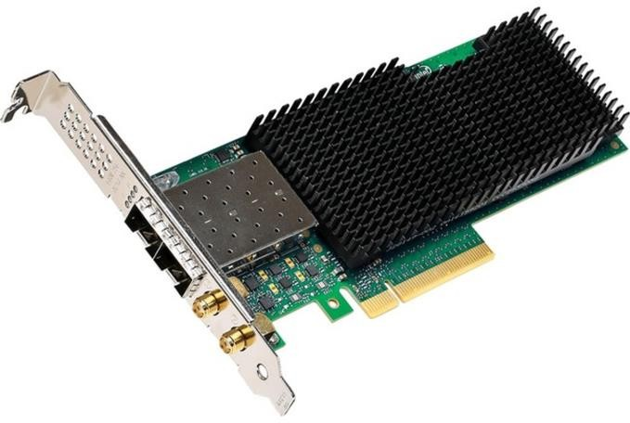
The absence of PTM is palpable
Intel XXV710-DA2T NIC with PPS daisy chaining capability
OCP-TAP Timecard connected with external loop to NVIDIA ConnectX-6 NIC

Slide 9
Part 2 Applications:
High Accuracy Timekeeping

Slide 10
What Can we do with it (Why)?
Inside a Machine
Precision Sync between devices on a system such as GPUs, NIC and CPU
Between Machines
Correlate events (such as logs)
Intermachine Telemetry (Compare Pipelines)
Align and Calibrate (Reduce Tail Latency)
Linearizability (Higher Precision Hybrid Logical Clocks for Consensus)
In a Network
One-way latency (precise measurement of packet journey across the network)
Congestion Control using deterministic traffic management

Slide 11
What comes out of this?
Machine X
Machine Y
Pseudo
Entanglement
Machine X and Y are any two machines across the globe or inside a local network
Pseudo Entanglement: Probabilistic Entanglement of two Registers (Machine Y and Y) within the Windows of Uncertainty Window of Uncertainty: An ongoing estimation of a time interval that UTC (or TAI) sits inside it (with a given probability)
UTC of TAI
Time
WOU

Slide 12
Time Precision and Applications
NTP
PTP
Industry Standard Physical Clocks
Packet Latency
^{Userland} (Globally) OS
Packet Latency (P2P)
WR
INT
DC like a PC MMU
500ms 100ms 20ms 2ms 1ms 500us 250us 100us 50us 20us 5us 1us 500ns 100ns 10ns 1ns ^{100p} 10ps 1ps
s
Real Time Linux
Disk
Operations
DDP
CCP
NTP
Industry Platform
PTP
WR

Slide 13
Correlate Events Between Machines
Pseudo Entangled
Machine Local Time
Event 1234
Event 1235
Event 1236
Event 1237
Event 1238
Event 1239
Event 1240
Event 1403
Event 1404
Event 1405
Event 1406
Event 1407
Machine Local Time
Event 2044
Event 2045
Event 2046
Event 2047
Event 2048
Event 2049
Event 2050
Event 2051
Machine Local Time
Event 1653
Event 1654
Event 1655
Event 1656
Event 1657
Event 1282
Event 1283
Event 1284
Event 2077
Event 2078
Machine A
Machine B
Machine C

Slide 14
Runtime Difference in a Pipeline
Time Axis
Machine A
Machine A
Machine A
Machine A
Machine B
Machine B
Machine B
Machine B
Pipelines
Machine C
Machine C
Machine C
Machine C
Machine D
Machine D
Machine D
Machine D
Epoch #1

Slide 15
Tail Latency
Time Axis
Machine A
Machine A
Machine A
Machine A
Machine B
Machine B
Machine B
Machine B
Pipelines
Machine C
Machine C
Machine C
Machine C
Machine D
Machine D
Machine D
Machine D
Epoch #1

Slide 16
Align and Calibrate Machines in a Pipeline
Time Axis
Machine A
Machine A
Machine A
Machine A
Machine B
Machine B
Machine B
Machine B
Pipelines
Machine C
Machine C
Machine C
Machine C
Machine D
Machine D
Machine D
Machine D
Epoch #1

Slide 17
Precision Time
2023-04-12
In the Last Centimeters

Slide 18





















Precision Time is a Foundational Capability
Time Sync required and Deadlines must be met
Automotive
Industrial / CPS
Conferencing
Live A/V
AR/VR
and Gaming
Mobile Robots
Time Sync is required
[Sometimes
Deadlines too]
5G / Comms
Financial
Cloud
Edge
HPC
Where Time Bounds are Necessary for Correctness of the Application, Compliance, etc

Slide 19









Time Synchronization Measurement Methodology
Application
Application
System Clock
“Now”
System Clock
“Now”
CPU Clock
(TSC)
TGPIO
TGPIO
CPU Clock
(TSC)
Oscilloscope / Logic Analyzer
PCIe
PCIe
Network Interface
Network Interface
offset
Software
Network
Hardware
Network Reference Clock

Slide 20
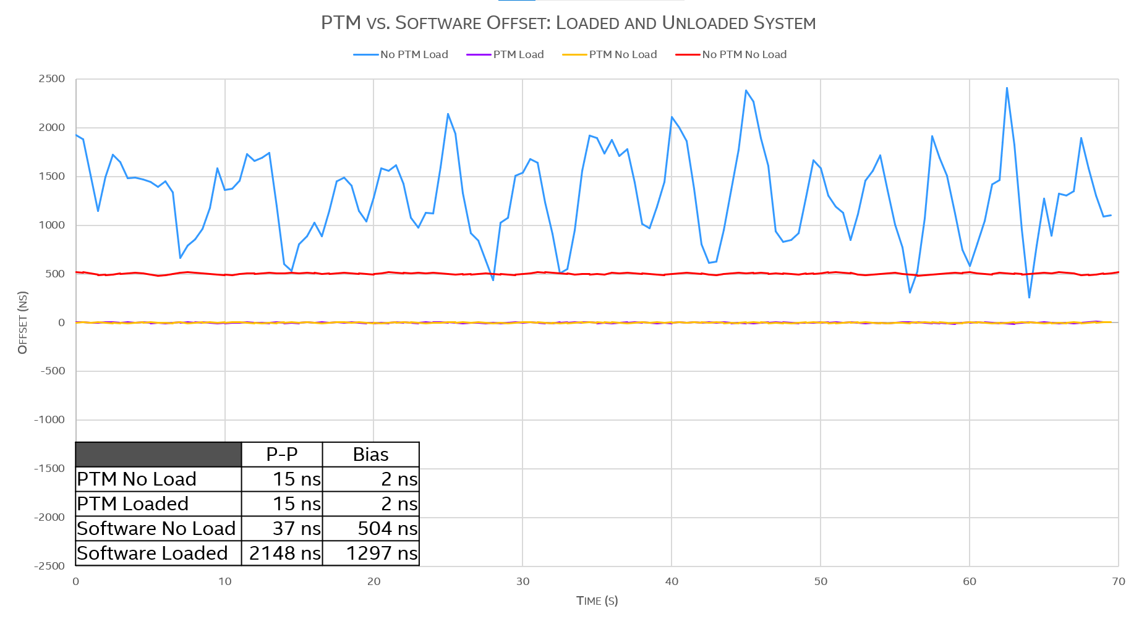
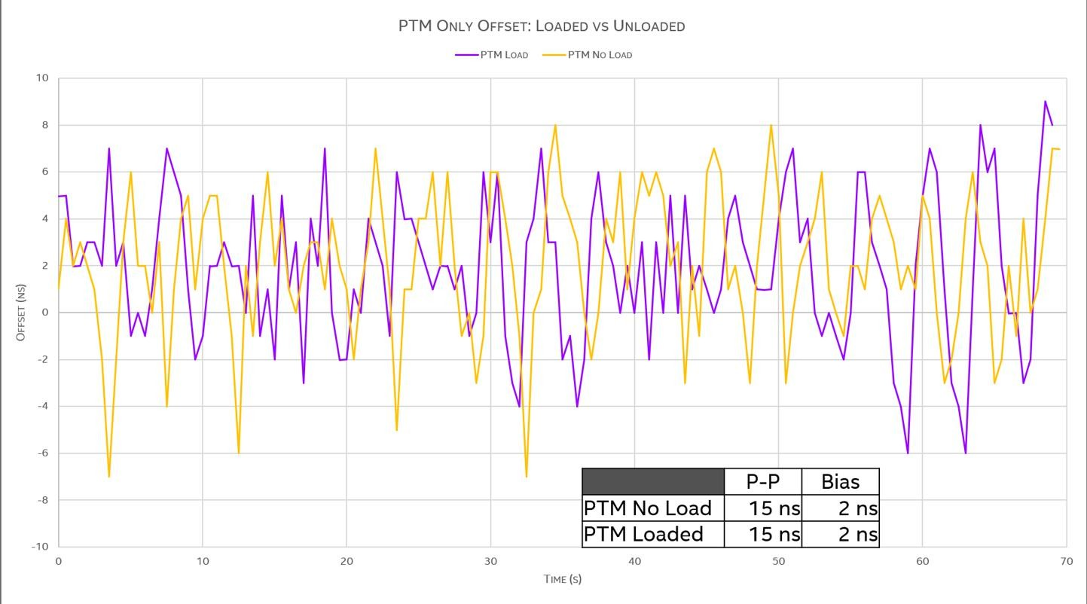
Loaded, No PTM
Idle, No PTM
With PTM (loaded & unloaded)

Slide 21
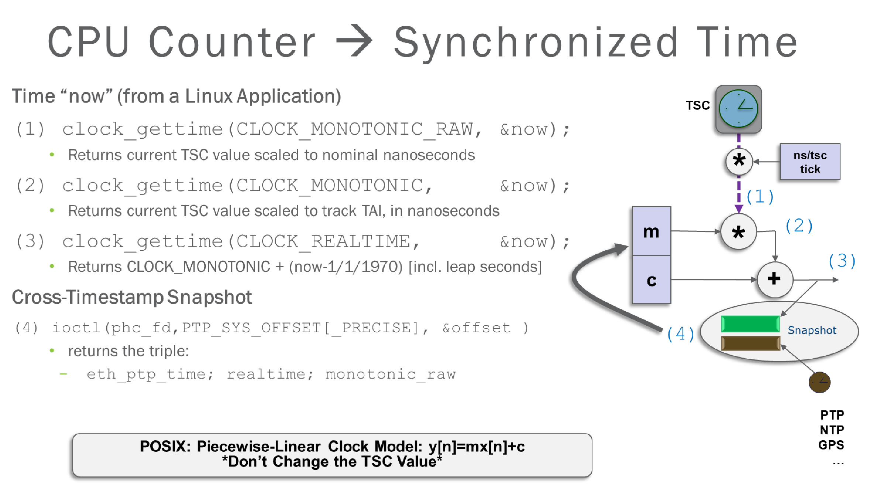

Slide 22



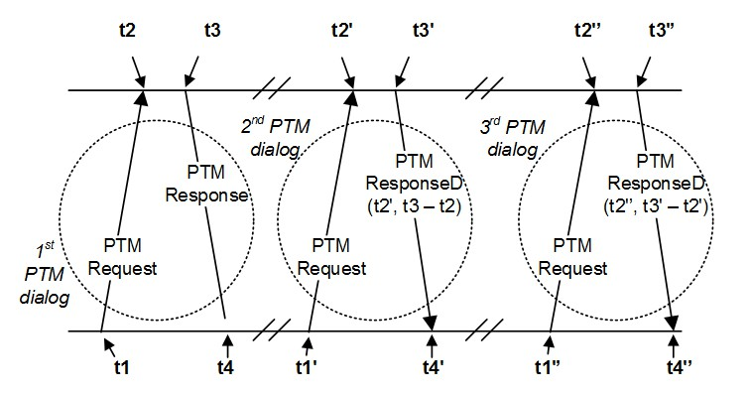







Using PCIe PTM to Capture Cross-Timestamps
Sample Scenario:
Computer
System
Device Driver Triggers Cross-Timestamp
Device initiates PTM Request TLP to Root Complex
System Time is Returned (delays are compensated )
(PTM Time, PTP Time) returned to NIC Device Driver
Software “disciplines” Coefficients per clock: m (and c)
System Time
PCIe Root Complex
Delays over PCIe links and through Switches are corrected
Cross Timestamps, Captured Simultaneously
System Time_1
Switch
From PCIe Specification
PTP Network Time
NIC
Other I/O Device
System Time_2
Other I/O DeviceTime
LAN
Cross Timestamps ➔ ‘m’ and ‘c’ Coefficients

Slide 23




PTM with a PCIe Switch
Endpoint A Initiates PTM Request upward
At the request of Software
Or on its own
Switch initiates PTM Request upward
Root Port Responds with the time downward
Delays measured and compensated
Switch Responds with the time downward
Delays measured and compensated
Endpoint knows the PTM Leader Time
Root Complex
PTM Leader Time
Switch
Endpoint B
Delays measured and added to the PTM Time
Endpoint A
Link delays, PCIe SERDES Delays
Duration between 3. to 4. above

Slide 24

PTM – device side
1

Slide 25


Peripheral devices & sync
Synchronization signal originates from the outside anyway
Multiple ways to get to the platform:
PTP
SyncE (+phase)
GNSS
PPS
refclk input (+phase)
peripheral device 1
CPU
peripheral device 2
2

Slide 26
Is it enough?
tbh it was, for a long time
there was always some way to coarsely synchronize CPU and other peripheral devices
precise synchronization was the domain of specialized/embedded/purpose-built systems
even most of the early usecases for commodity platforms were network-oriented (TSN, 5G fronthaul, …)
and so could be offloaded to the peripheral device
more usecases started popping up, often with demands for CPU/non-network timestamping
schedulers (e.g. 5G)
processing of realtime data (e.g. Holoscan sensors)
time-driven CPU applications (e.g. distributed databases)
time-driven GPU applications (e.g. distributed rendering)
consistent profiling of distributed applications

Slide 27
Intra-Platform Distribution
How to deliver synchronization to other devices in the system?
Option 1:
Each device gets outside connection and is independently synchronized to external signal
For network-derived signals, even non-networking devices need a network port
Option 2:
Out-of-band: extra synchronization cabling between devices
E.g. daisy-chain PPS signals of all network adapters
Option 3:
In-band: over PCIe bus
with/without support for PCIe synchronization features

Slide 28
Quick segue
time uncertainty
New time-sensitive applications require estimating local clock uncertainty
We never had a way to be sure about time on x86
which is problematic for True-Time-like APIs
Can always assume worst case, I guess?
But what is the worst case, really?
monitor PPS In events (testptp)
phc2sys
phc2sys
generate PPS Out signals (testptp)
NIC 1
CPU
NIC 2
PPS
Tested with NIC1 -> CPU -> NIC2 -> PPS Out -> PPS In
saved $$$ on oscilloscopes/”spectroscopes” ☺
Measured 100s of nanoseconds
Suspected smoothing effect of the CPU in the middle
5

Slide 29
how device <> CPU sync works today
kernel
SYS.clk
DEV.clk
SYS_pre DEV
= read(SYS.clk)
= read(DEV.clk)
SYS_post = read(SYS.clk)
SYS = (SYS_pre + SYS_post) / 2 DEV_SYS_offset = (DEV – SYS)

Slide 30

More like…
kernel
SYS.clk
DEV.clk
The PCIe wonderland

Slide 31
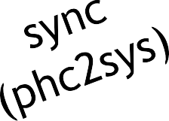
Test platform
schematic
SPR-based server
Oscilloscope
Keysight DSO-X 3034A
ch1
iperf client
x4
iperf client
iperf client
iperf client
iperf client
iperf client
ppppss
iperf client
iperf client
iperf client
iperf client
iperf client
iperf client
out
Port 0
~120
Gbps
ConnectX-7
iperf server
x4
ch3
iperf client
iperf client
iperf server
iperf client
iperf client
Port 1
iperf server
iperf client
iperf client
iperf server
iperf client
iperf client
sys clk
TGPIO

Slide 32
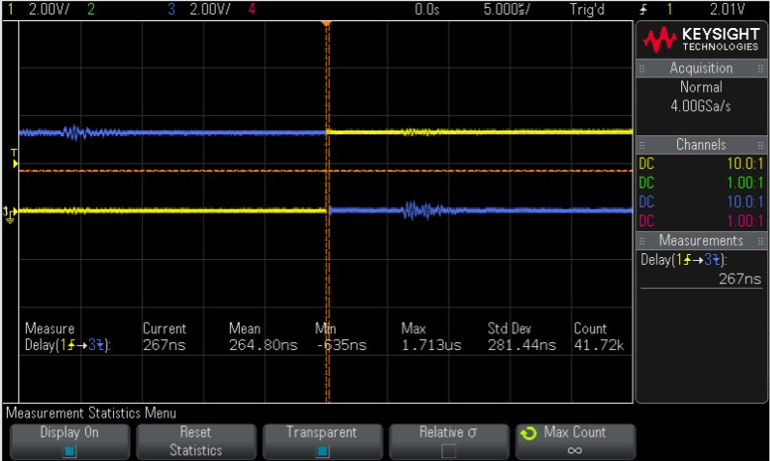
NIC → CPU sync
11-hour run, no PTM (yet)
Adjust CPU time 8 times/second
For each adjustment, measure CPU/NIC time diff 15 times, use “luckiest” measurement
iperf - loaded system CPU/NIC time error:
min: | -635.0 | [ns]
max: | 1713.0 | [ns]
pk-pk: | 2348.0 | [ns]

Slide 33
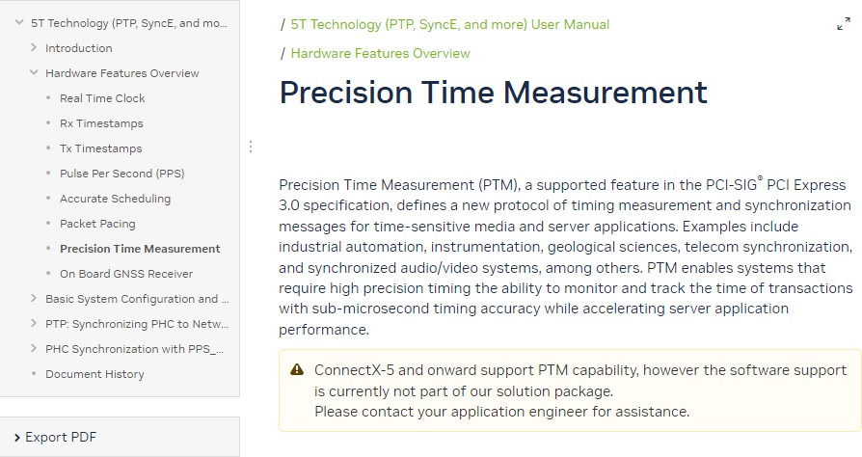
Let’s talk about PTM
simple spec
special PCIe messages
HW timestamping of ingress/egress
distributes “master” time [in nanoseconds]
PTM “master” time doesn’t have to be the
wall-clock-external-reference-time
It’s a “ruler” by which every device in the platform gets to measure the passage of its local time
NVIDIA Connect-X has it
need 2 to tango

Slide 34
What it takes
on the device
PTM (Requester) MVP for any peripheral device:
a counter
ability to send PCIe messages with configurable opcode
PCIe logic to recognize special opcodes and snapshot the counter when messages with those special opcodes are sent/received
In flit mode (gen 6+), it’s even simpler
some way to communicate information to the host
R/W PCIe capability register
To illustrate, my entire implementation for PTM is ~300 LOC, including documentation

Slide 35
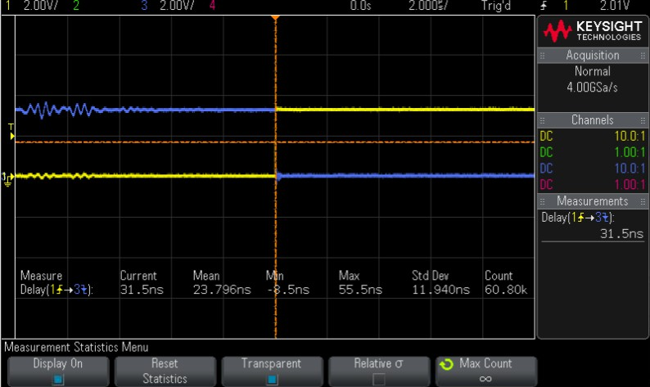
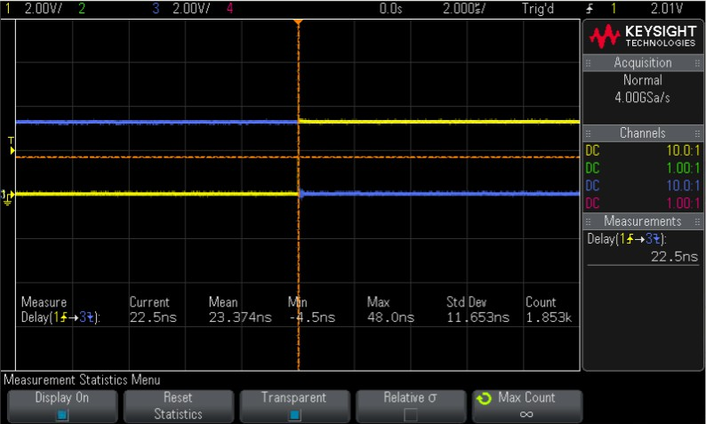
NIC → CPU sync
with PTM, 16-hours run
Adjust CPU time 8 times/second
For each adjustment, measure time difference between CPU and NIC once
(iperf) loaded system CPU/NIC time error:
min: | -8.5 | [ns]
max: | 55.5 | [ns]
pk-pk: | 64.0 | [ns]

Slide 36
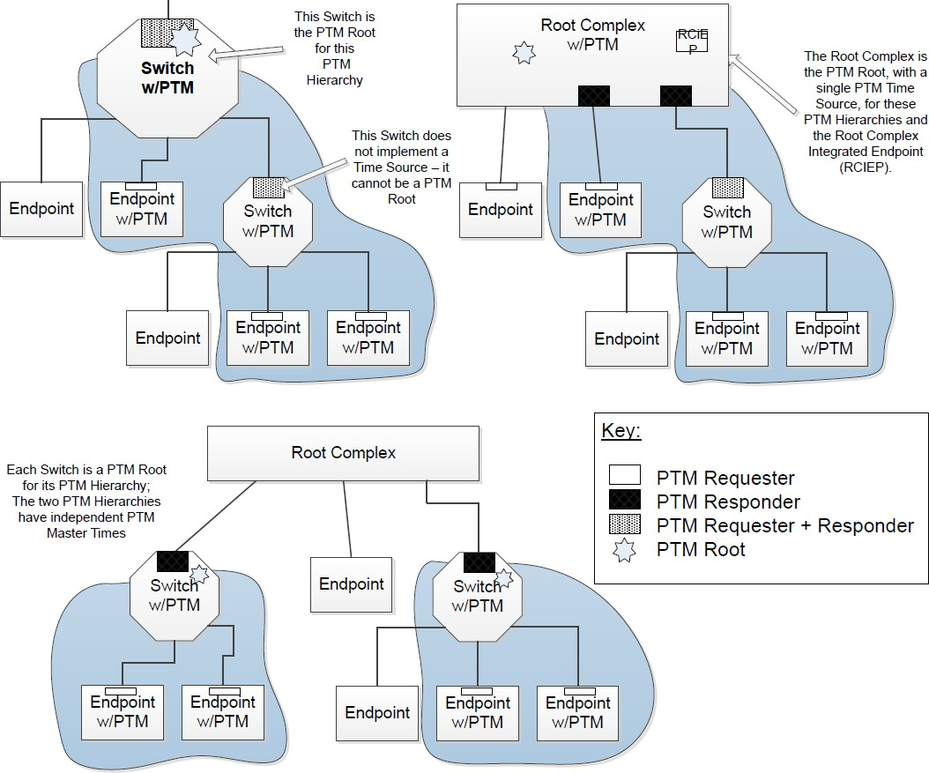
Are we done?
device drivers: not quite
Though basic support is available in upstream Linux, there are a few flaws
Device driver is asked to cross-timestamp with system clock. What is the relation between PTM Master Time and system clock?
Current upstream code assumes ART derivative is used for PTM Master Time.
And that CLOCK_REALTIME is based on TSC.
And that TSC is related to ART.
PTP_SYS_OFFSET_PRECISE API allows cross- timestamping device/system clocks.
What about device/PCIe switch?
PCIe switch can act as a sort of “boundary clock”
Maybe Linux kernel needs an explicit notion of “PTM Master Time” and its constant relation with CLOCK_REALTIME (in case TSC/ART is used)
13

